Slide 1

Estimating the Price of S&P 500 Using Economic and Financial Indicators
Group: Stonks Go Up
Liam Otten, Cocoro Wachi

Slide 2
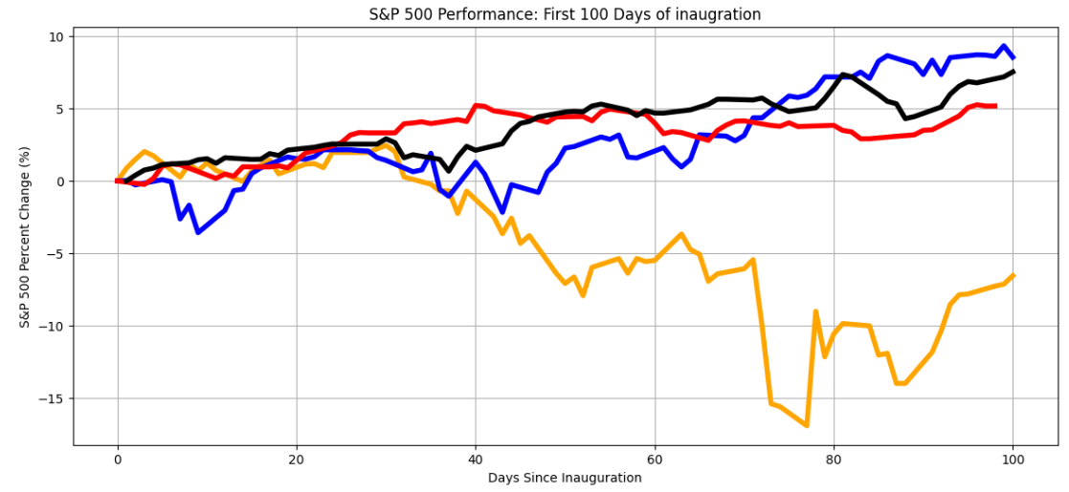
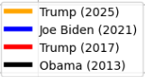
Background
The S&P 500 (Standard’s & Poor’s 500) tracks the top 500 largest publicly traded companies
Movement of S&P reflects a broader economic trend
Many factors like international/political events, macroeconomic trends affect S&P price
It’s hard to predict!!

Slide 3

Purpose
This project focuses on past movement of key financial indicators, ignoring other influences
See how effective a simple model like a Linear Regression works with a complex index.
Create a model that predicts future price using movement from 60 previous days
Hypothesis
H : Indicators such as Dow Jones index, US GDP, CPI, HPI, and Foreign Exchange have no correlation with the price of S&P 500
0
https://money.cnn.com/2015/11/29/

Slide 4
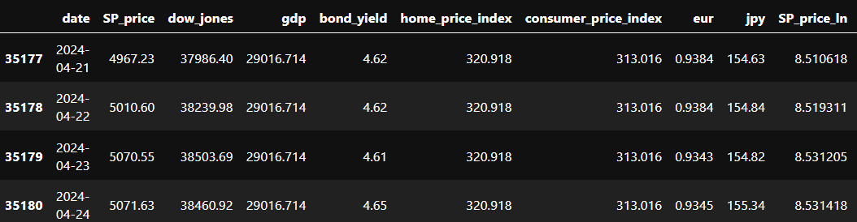
Features
Data was pulled from a variety of sources
This project uses daily/monthly/quarterly data from 1/1/1987 to 3/25/2025 – about 38 years
Dependent variable is the S&P 500 Price
Feature variables:
S&P 500, Dow Jones index, US GDP, USD/EUR, USD/JPY, Home Price Index
(HPI), Consumer Price Index (CPI), Federal Bond Yield.
All are public information and relatively known to common people.

Slide 5
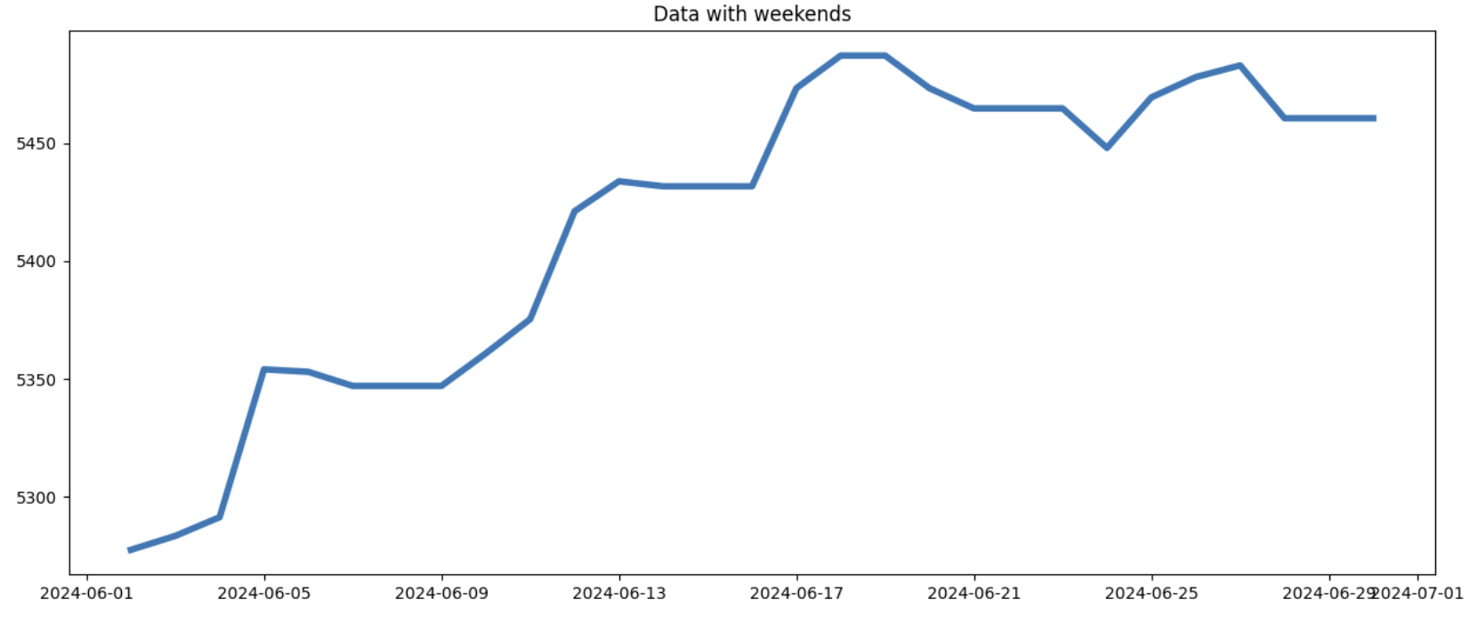
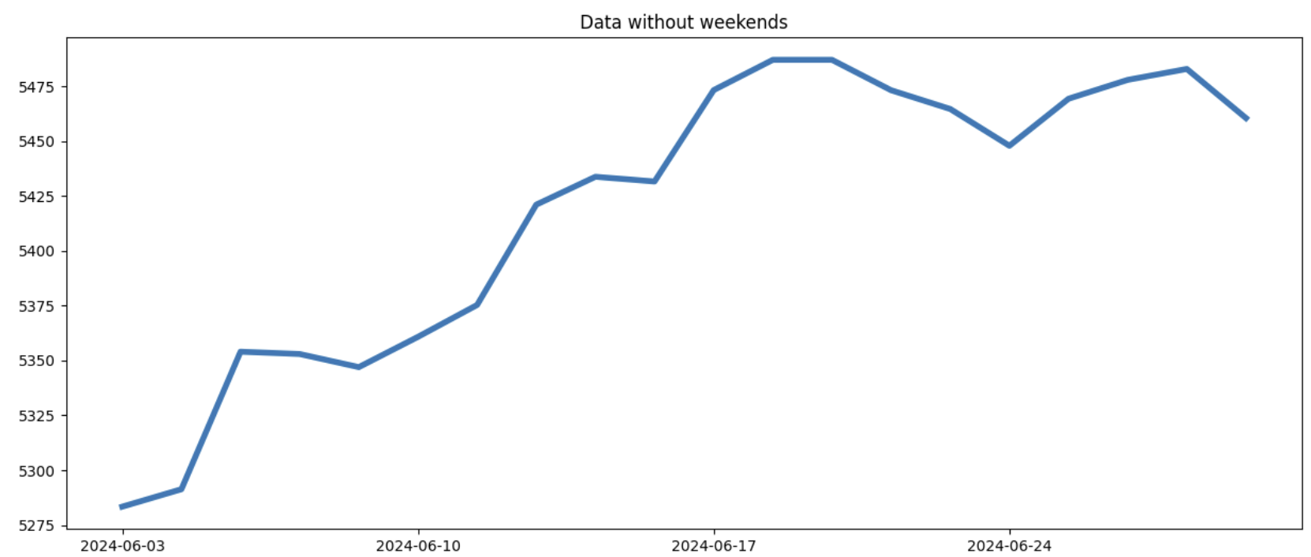
Time Series Features
Used ffill() to create continuous data for non-daily data
Filtered out weekends since market is closed -> affects accuracy
Data with exponential growth was linearized using log
Was determined by visualizing each data and decided manually

Slide 6
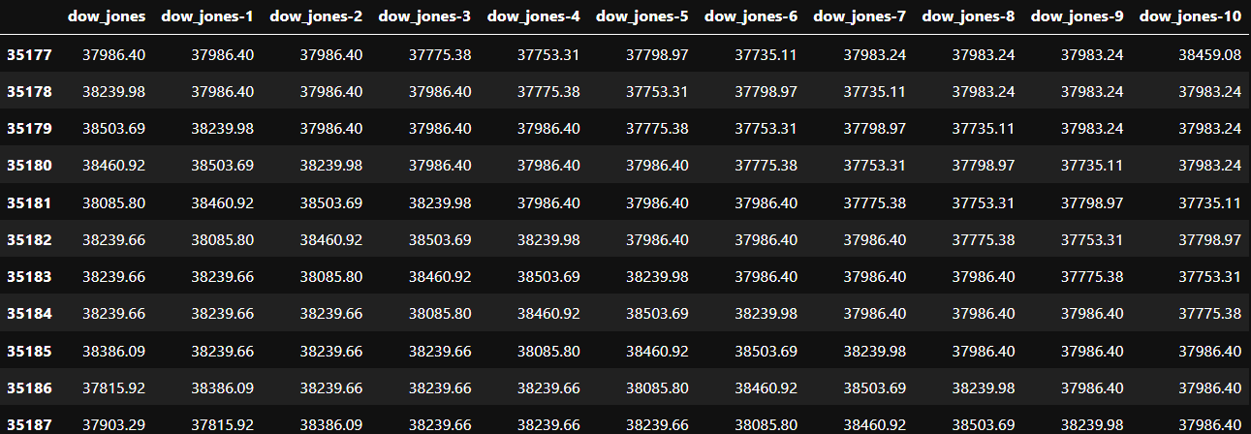
Feature Engineering
For each daily feature, we added 60 extra features for each of the 60 previous days
The linear Regression we developed uses 480 total features (8 features × 60 days)
From there, we selected the highest influencing features to remove redundancy
Implemented a greedy model -> uses 117 features

Slide 7
Model
Used scikit-learn Linear Regression
Data used for training were standardized
Idea 1: Predict 10 days into the future all at once, using the 60 previous days
Idea 2: Predict next days price using 60 previous days relative to the prediction

Slide 8
Idea 1: Predict 10 days into the future all at once, using the 60 previous days
Only one linear regression model, Easy to understand
Liam can you fill in this slide
I think the reason why this model is so pessimistic is because of Mean-reversion bias. So use that to say why we didn’t use this model.
Also include some visual

Slide 9
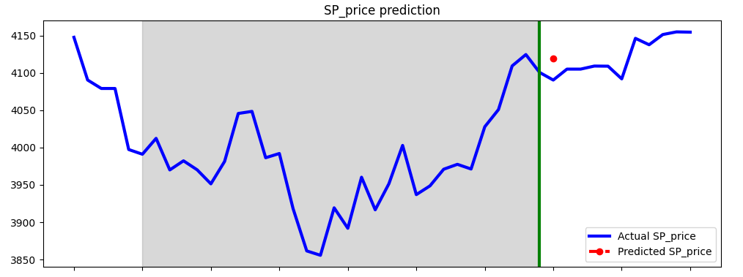
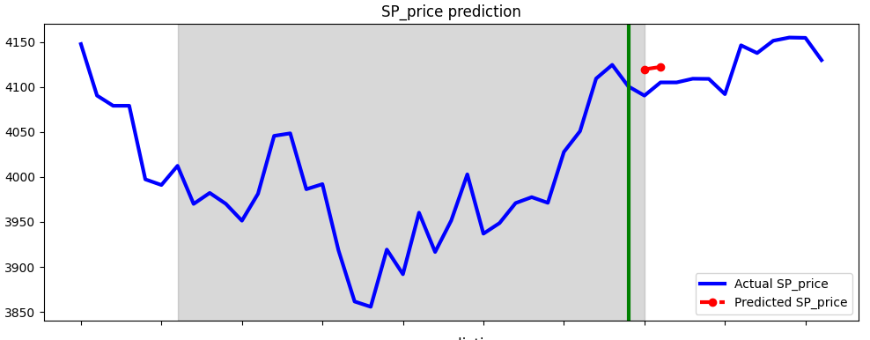
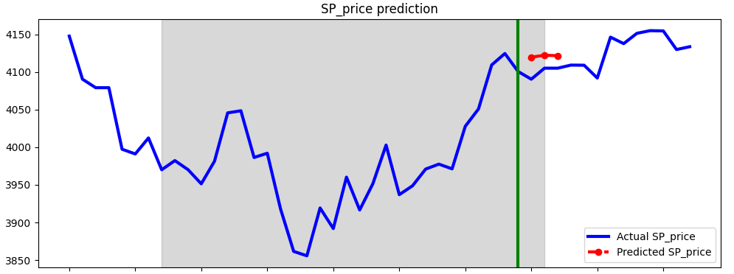
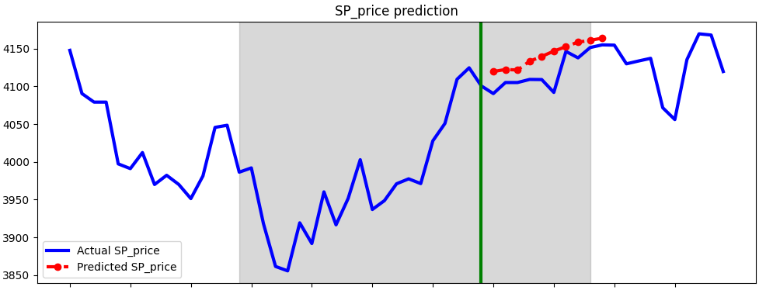
Model
Idea 2: Predict next days price using data from 60 previous days relative to the prediction
Recursive approach with moving window
Needs previous days data for all four features
Trained linear model for multiple features

Slide 10
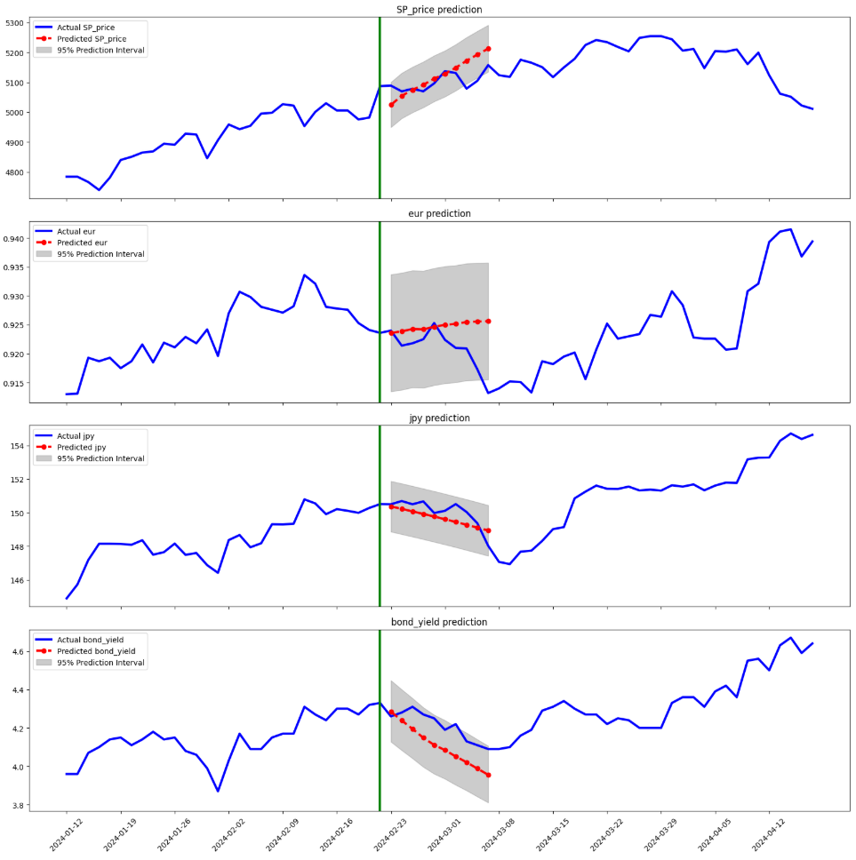
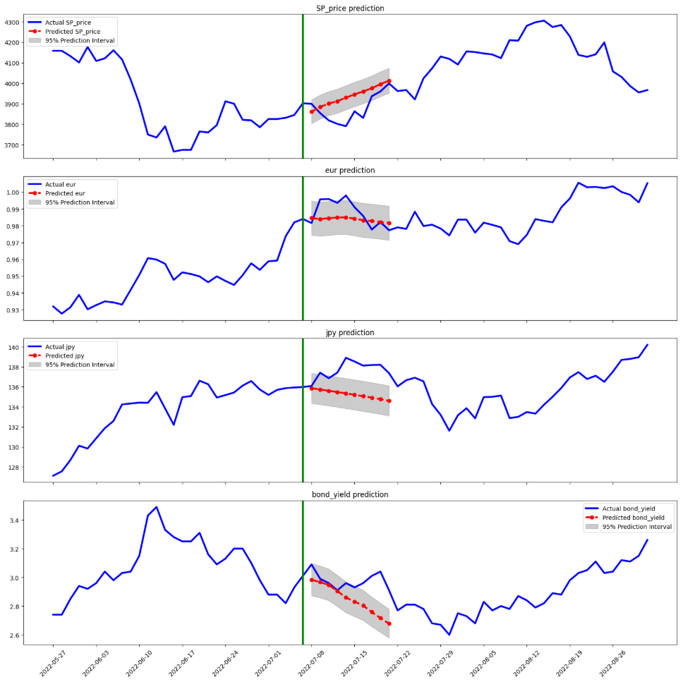
Result
Prediction from 2024-2-23
Prediction from 2022-7-8
S&P
EUR
JPY
Bond

Slide 11
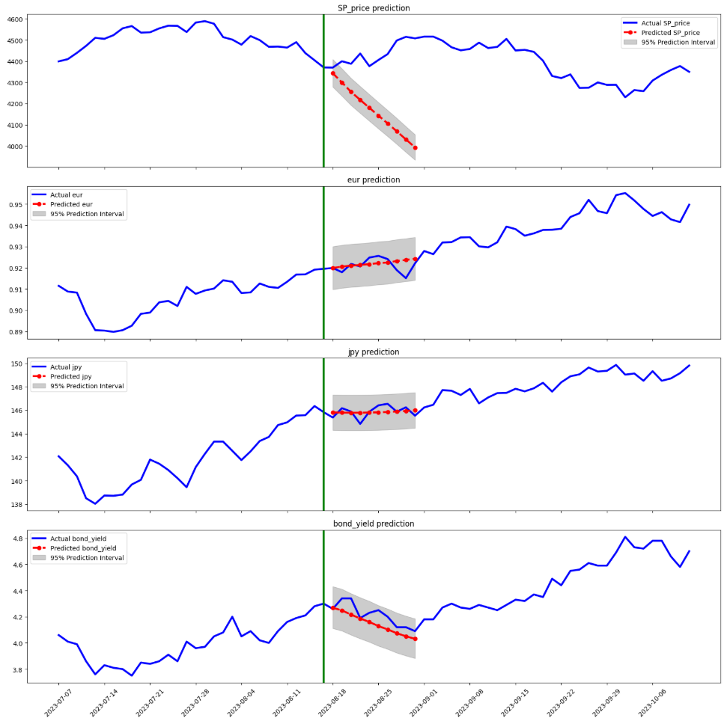
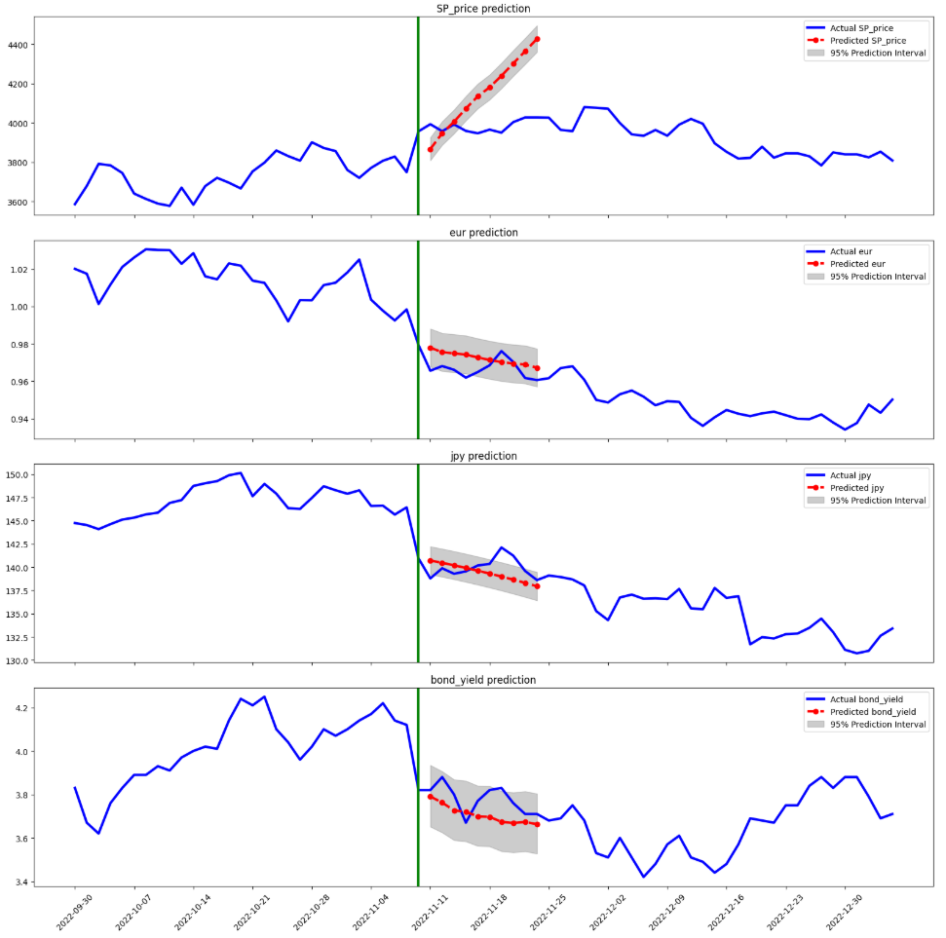
Result
Prediction from 2023-8-18
Prediction from 2022-11-11
S&P
EUR
JPY
Bond

Slide 12
Conclusion

Slide 13
Improvements/Discussion

